Slide 1
1. Unusual Monohybrid Ratios
    Examples of:
    Codominance
    Incomplete dominance
    Lethal alleles
    Multiple alleles

Slide 2

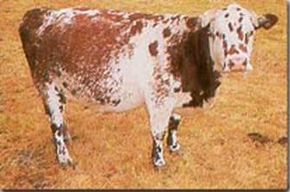
This is a roan cow
RR red,
RR’, roan
R’R’white

Slide 3
Co-dominance
Two different alleles at the same locus are both expressed
  E.g. roan cattle

Slide 4
Incomplete dominance
The allele for red snapdragons is not fully dominant over the allele for white.
Heterozygous individuals are pink
(NOTE: You can use R and r for the symbols but here is another way to show them.)

Slide 5
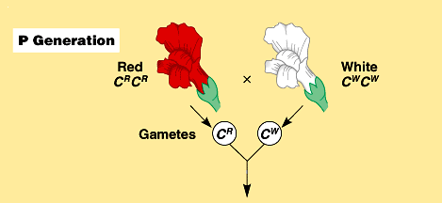
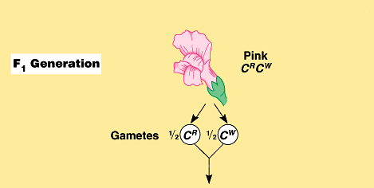
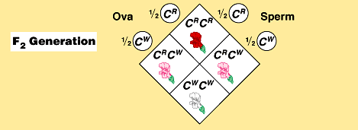

Slide 6
Co-dominance and Incomplete dominance
In co-dominance both alleles are active and expressed, e.g. roan cattle have both red and white hairs.
In incomplete dominance only one allele is active but is not fully expressed so that there is an intermediate phenotype, e.g. pink flowers rather than red.

Slide 7
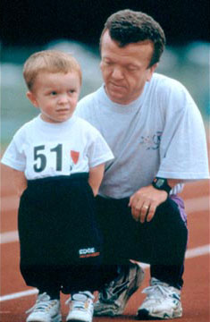
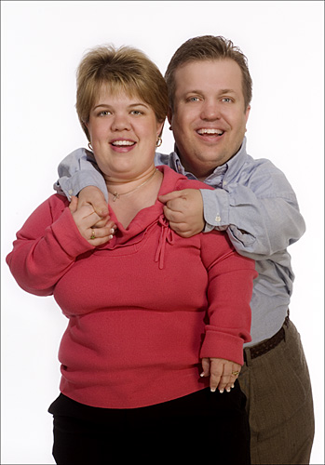
Lethal alleles
ACHONDROPLASIA

Slide 8
Lethal Alleles
The homozygous dominant genotype is lethal.
E.g. For the achondroplasia gene, most people are aa.
Aa individuals have the ‘dwarf’ phenotype
AA individuals can be conceived but die before being born.

Slide 9
Cross between two dwarves
Aa x Aa
A
a
A
A
A
A
a
dies
dwarf
a
A
a
a
a
dwarf
normal
Phenotype ratio – 2 dwarf :1 normal

Slide 10
Multiple Alleles
More than 2 alleles exist for one gene locus.
An individual can have any two of them so there are a number of different phenotypes
E.g. ABO blood group

Slide 11

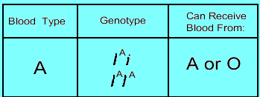
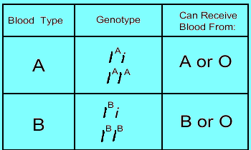
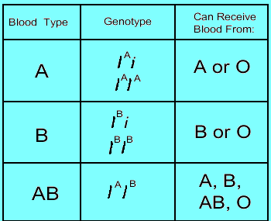
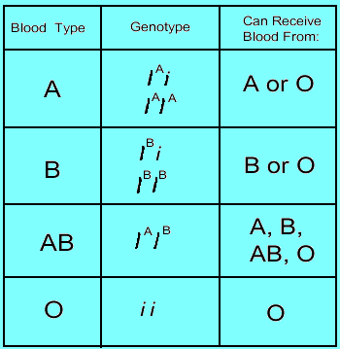
ABO BLOOD GROUP

Slide 12
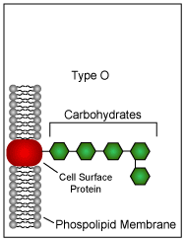
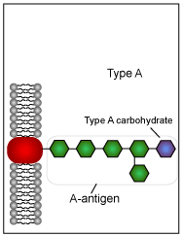
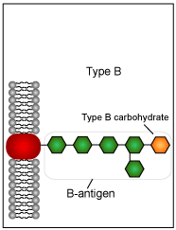
Antigens on RBCs

Slide 13
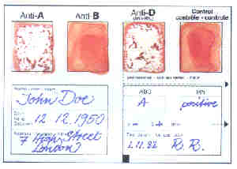
A test result

